Slide 1


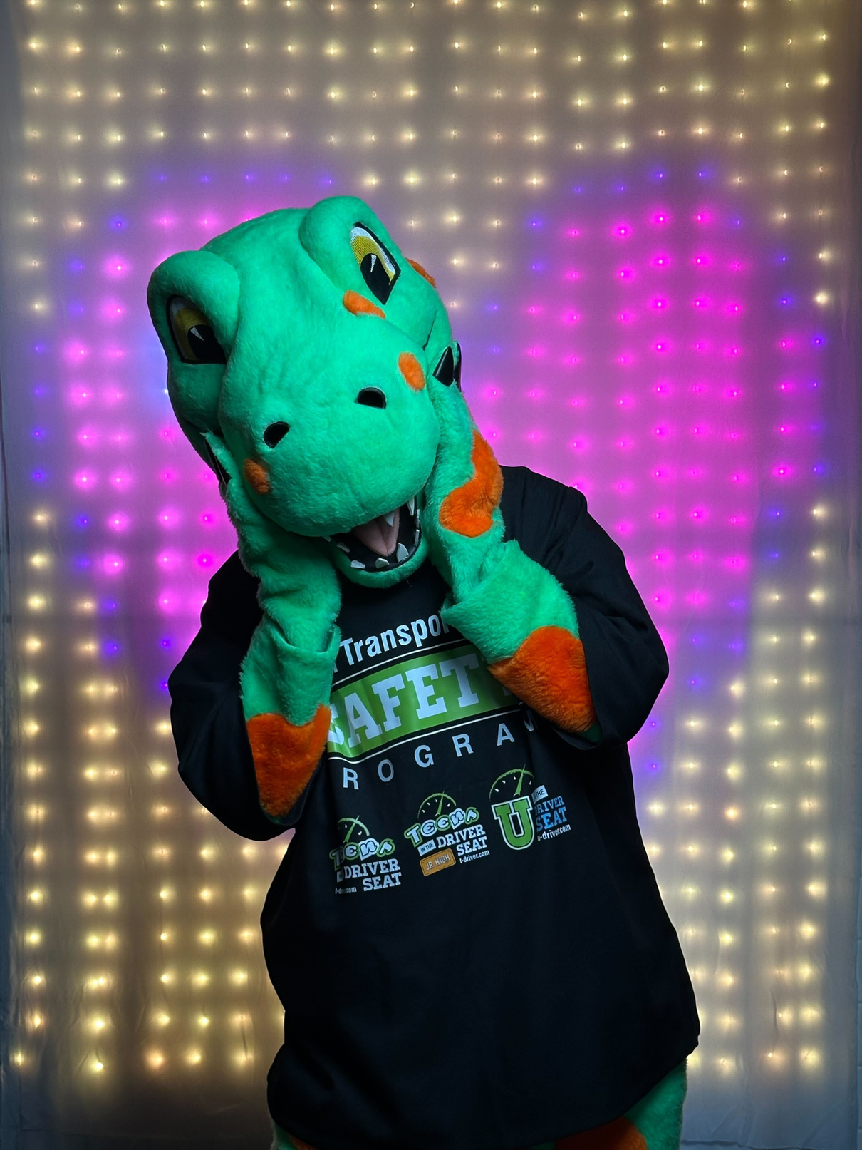




LET’S TALK
IMPAIRED DRIVING!
Impaired Driving Prevention Curriculum
Sponsored by:

Slide 2

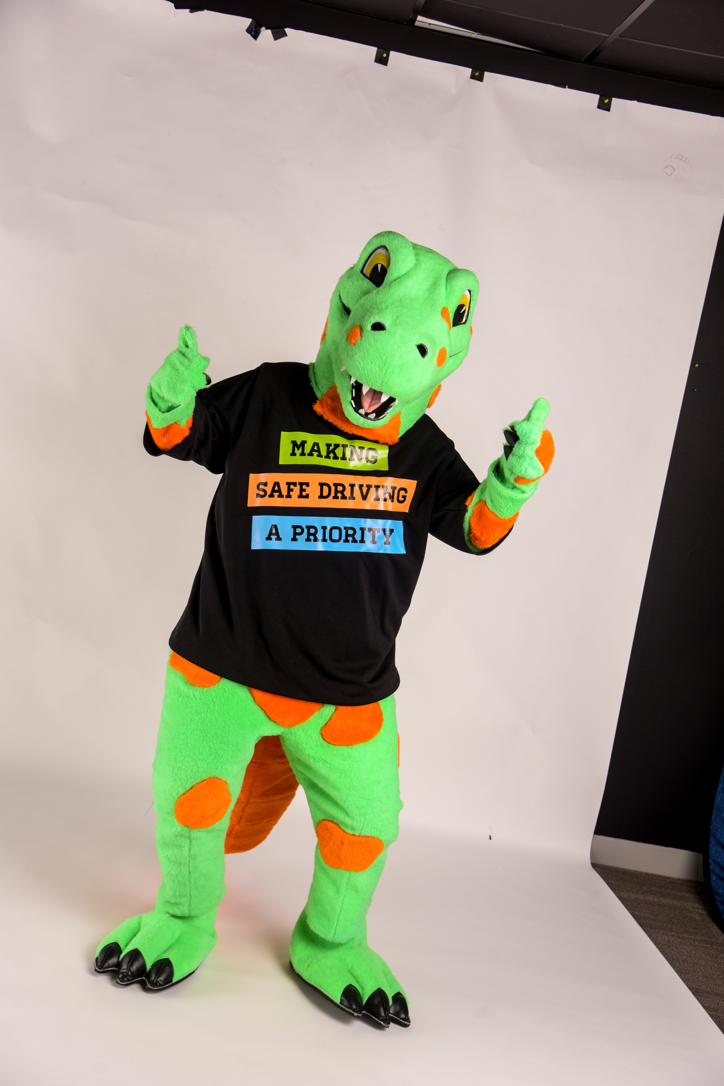
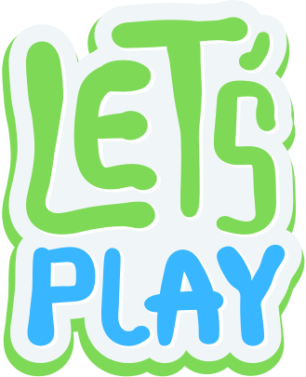

SPEAK (C)UP! NOT EVERYONE IS DOING IT
This fun cup-stacking activity can be used to bring awareness to impaired driving and help you start a conversation with your peers about the negative effects impairment has on a person’s ability to complete simple tasks and how teens can speak up for their safety.
Notes:
Please refer to the activity handout in the curriculum workbook.

Slide 3
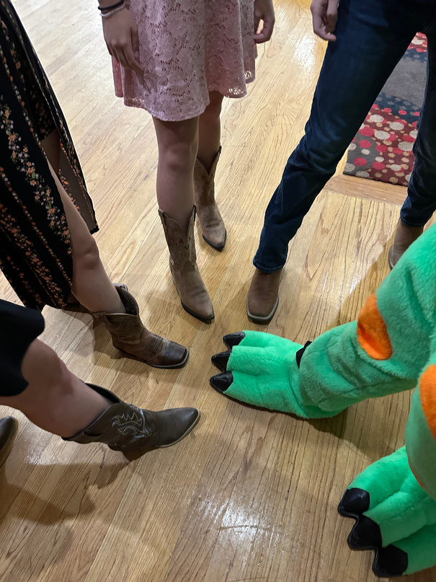
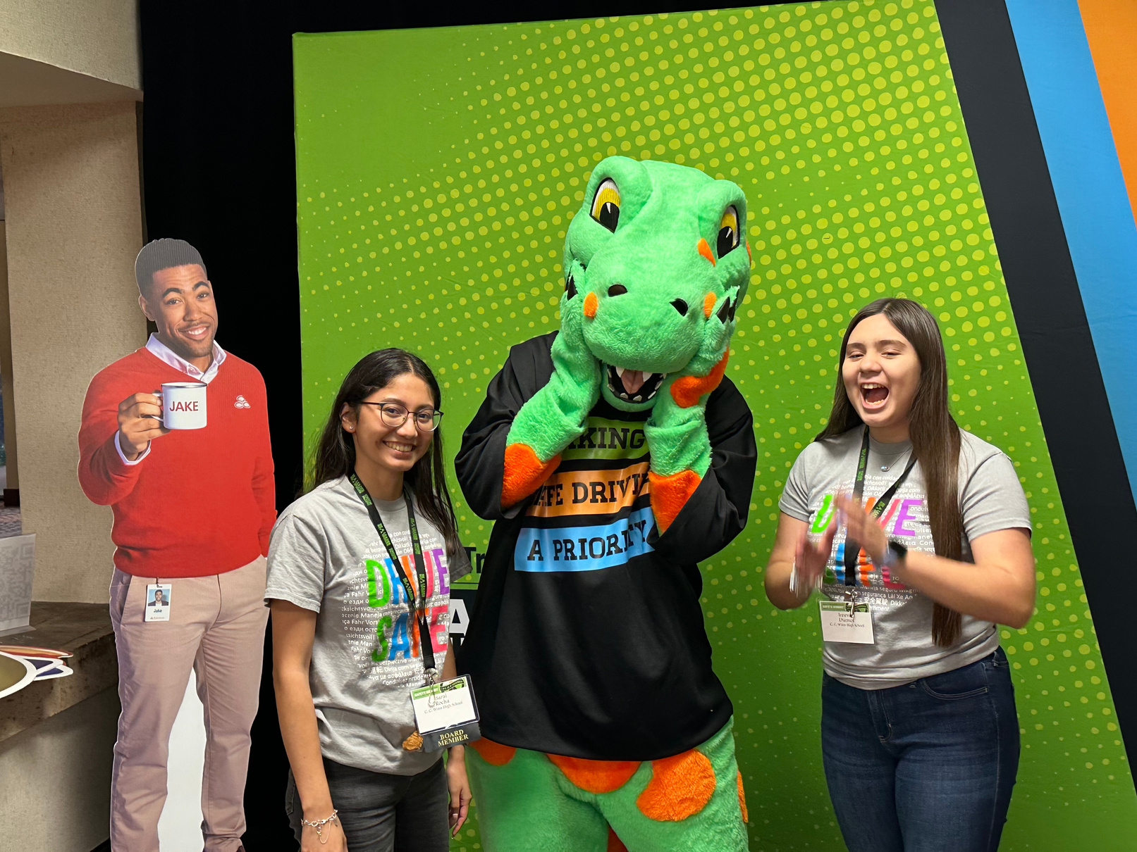
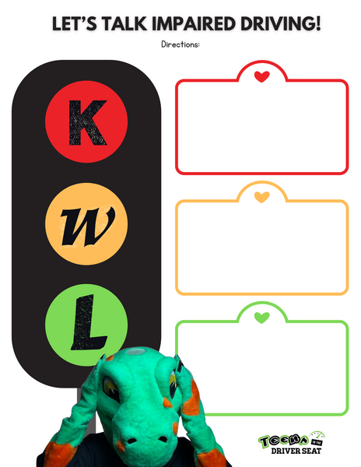
KWL
Before we start, let‘s fill out the ‘K’ (What we Know about Impaired Driving)!
Take some time to talk to your peers about Impaired Driving and then write at least 2-3 sentences on what you know about IMPAIRED DRIVING under the letter ‘K’
Notes:
Please refer to handout slides in the curriculum workbook.

Slide 4
KWL
Now, let’s share out! What did YOU write under letter ‘K’
Considering what we heard, let’s write 2-3 sentences under the letter ‘W’ for what we want to know during this lesson today.

Slide 5


What do you think?
What do you feel are some of the main causes for car crashes among your peers?
Learn More
Notes:
Now I'd like to ask your thoughts on what you think are some of the main reasons young drivers are at a higher risk of crashing?

Slide 6

CAR CRASHES
are a leading cause of injury and death for teens in the U.S.
NHTSA
Notes:
Car crashes are the leading cause of injury and death for young people. On average, we lose over 2700 teens annually across the nation and thousands more are injured.

Slide 7
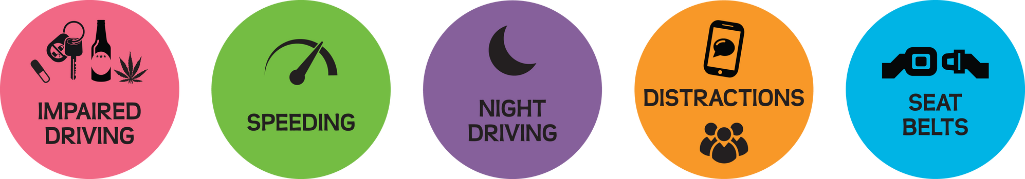

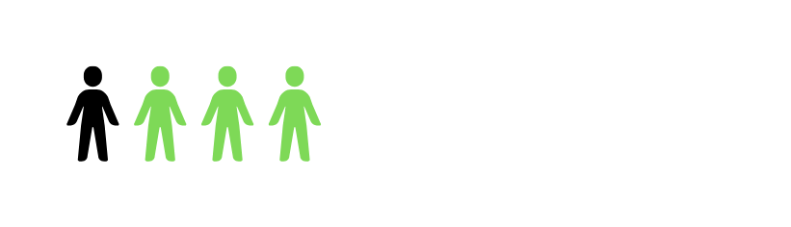

Impaired Driving
  Defined as driving under the influence of alcohol or drugs. Driving Under the Influence (DUI) is an offense specific to minors (under 21) who may get pulled over for impaired driving. Driving under the influence of alcohol and drugs is dangerous and illegal for any driver.
2022
1 in 4 fatal crashes in Texas involving 11-25 year-olds were impaired related.
Passengers 11-13 may have been riding with an impaired driver or hit by an impaired driver.
TxDOT
Notes:
Source: Texas Department of Transportation

Slide 8




Life is costly to lose.
A 13 year old passenger loses out on years of life.
65
potential years of life lost!
Notes:
Loss of life is calculated by subtracting the average life expectancy (78 years) from the age a person dies.
Source: CDC

Slide 9
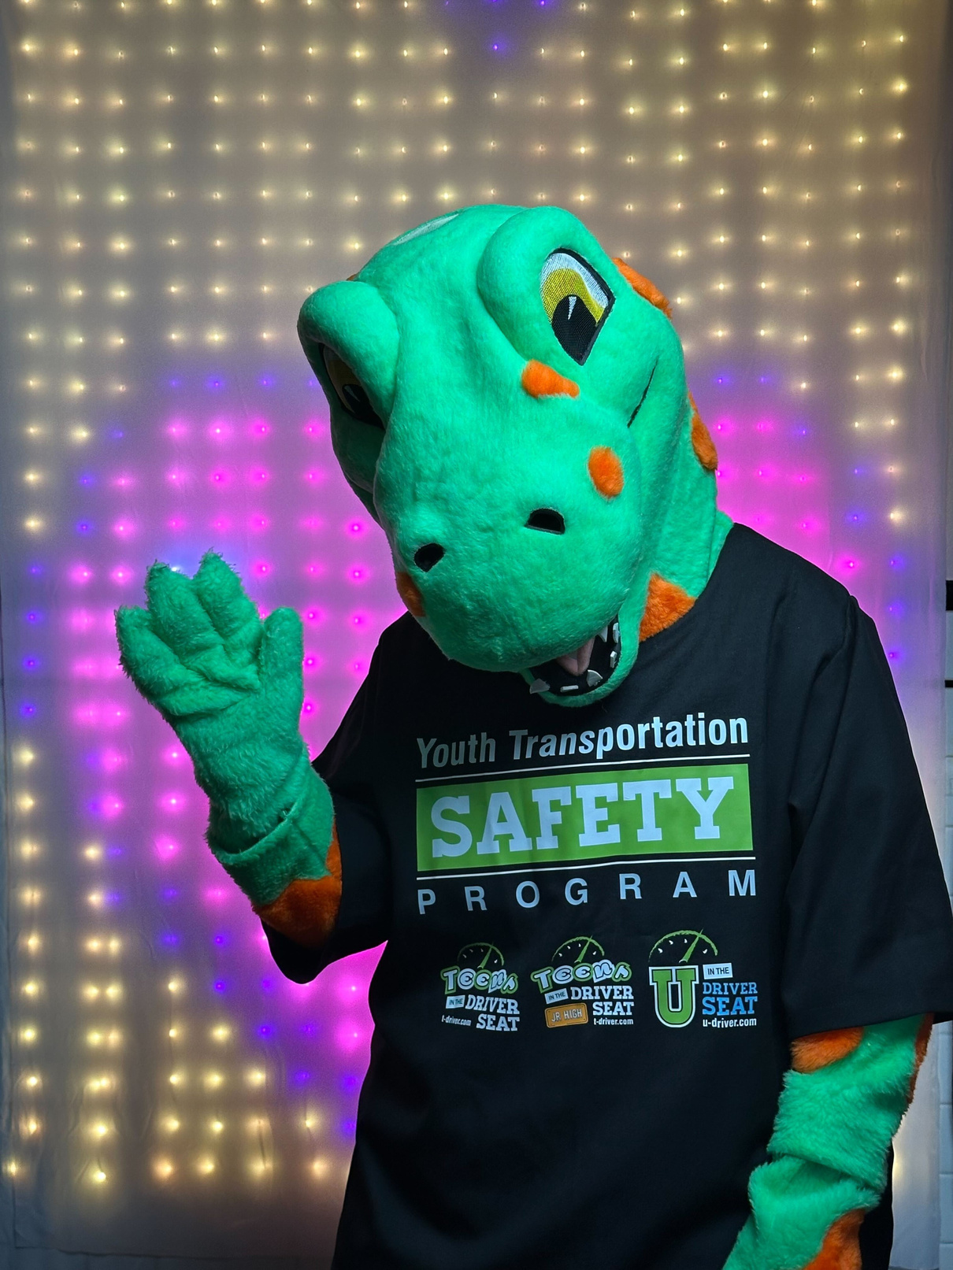
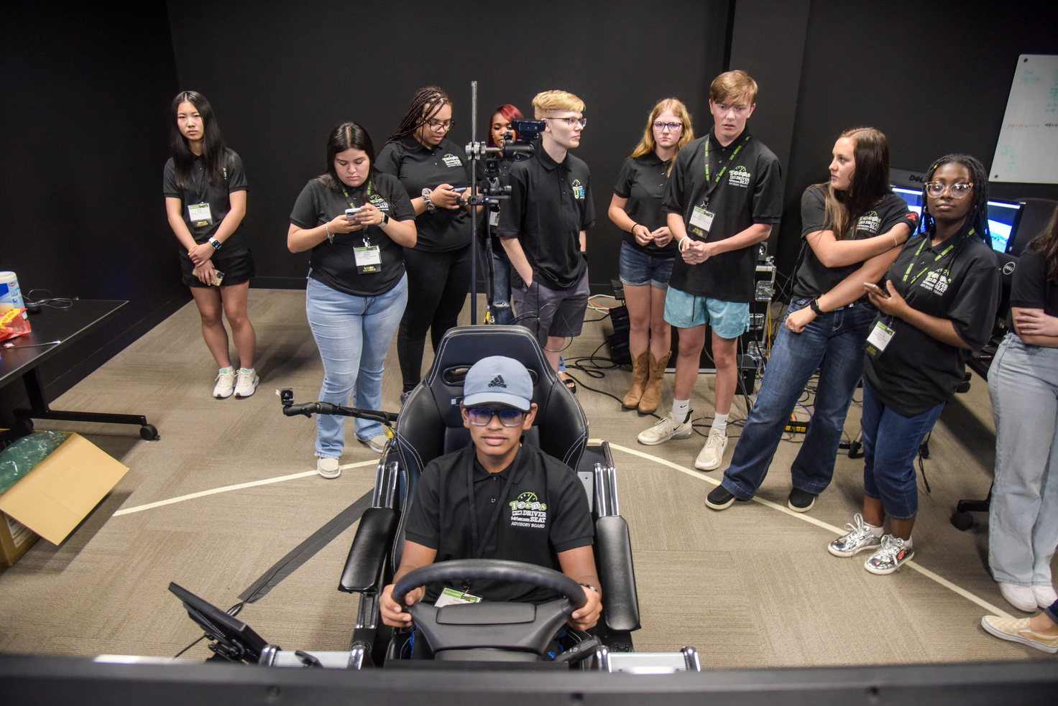
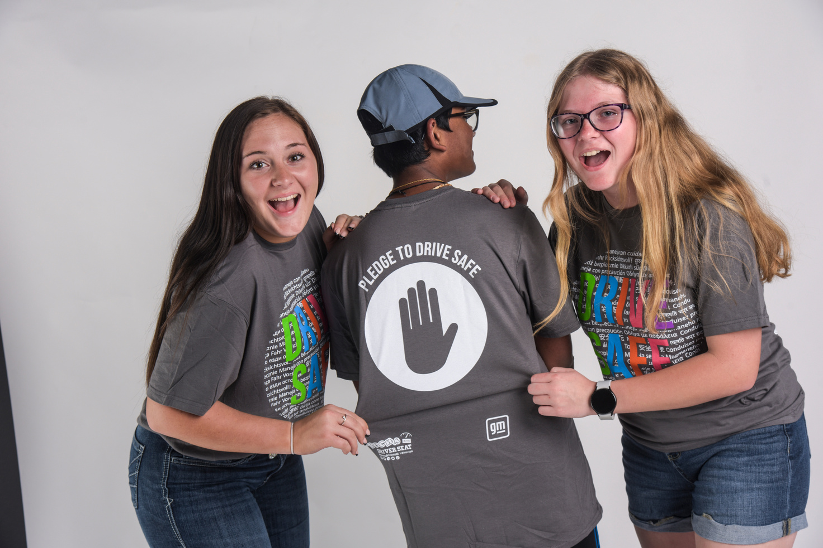
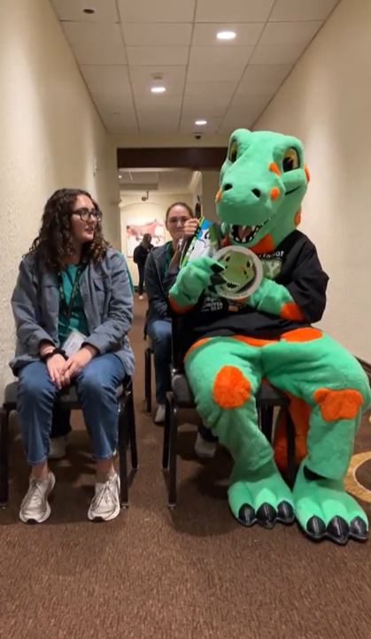

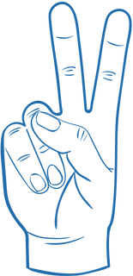
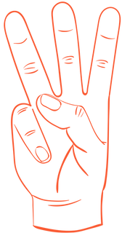
Show of hands...
I feel confident having conversations with my peers about traffic safety.
Not very
Somewhat
Very
Notes:
This question should aim to help understand a student's general comfort with having these kinds of conversations and can help establish a baseline for general outreach activities moving forward.
While this lesson will not cover skills to develop confidence, please connect with your regional representative for leadership workshops that do go into this in more depth.

Slide 10

Traffic Safety Citizenship
An act that is voluntary, without being rewarded or recognized, and that ultimately promotes safety that helps others. For example, reminding someone to put on their seatbelt before driving or stopping someone from driving distracted.
(Adapted from the Center for Health and Safety Culture)
Notes:
The concept of Traffic Safety Citizenship reminds students that they can be active participants in ensuring their safety and use their voices to help change the culture around safe driving by being active safety citizens. This also acknowledges that, while they will not receive a formal award for this behavior, it is in the best interest of society as a whole and that is also a type of reward.

Slide 11
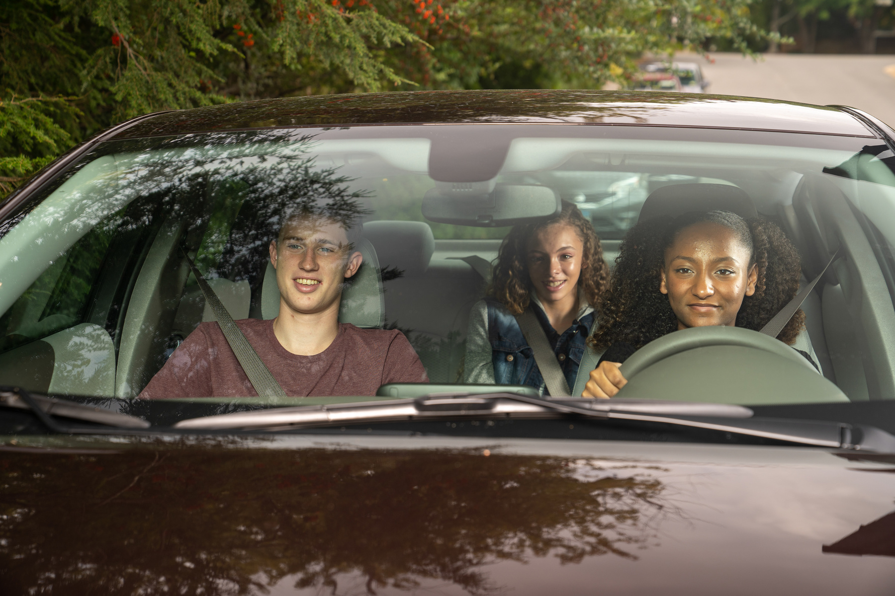

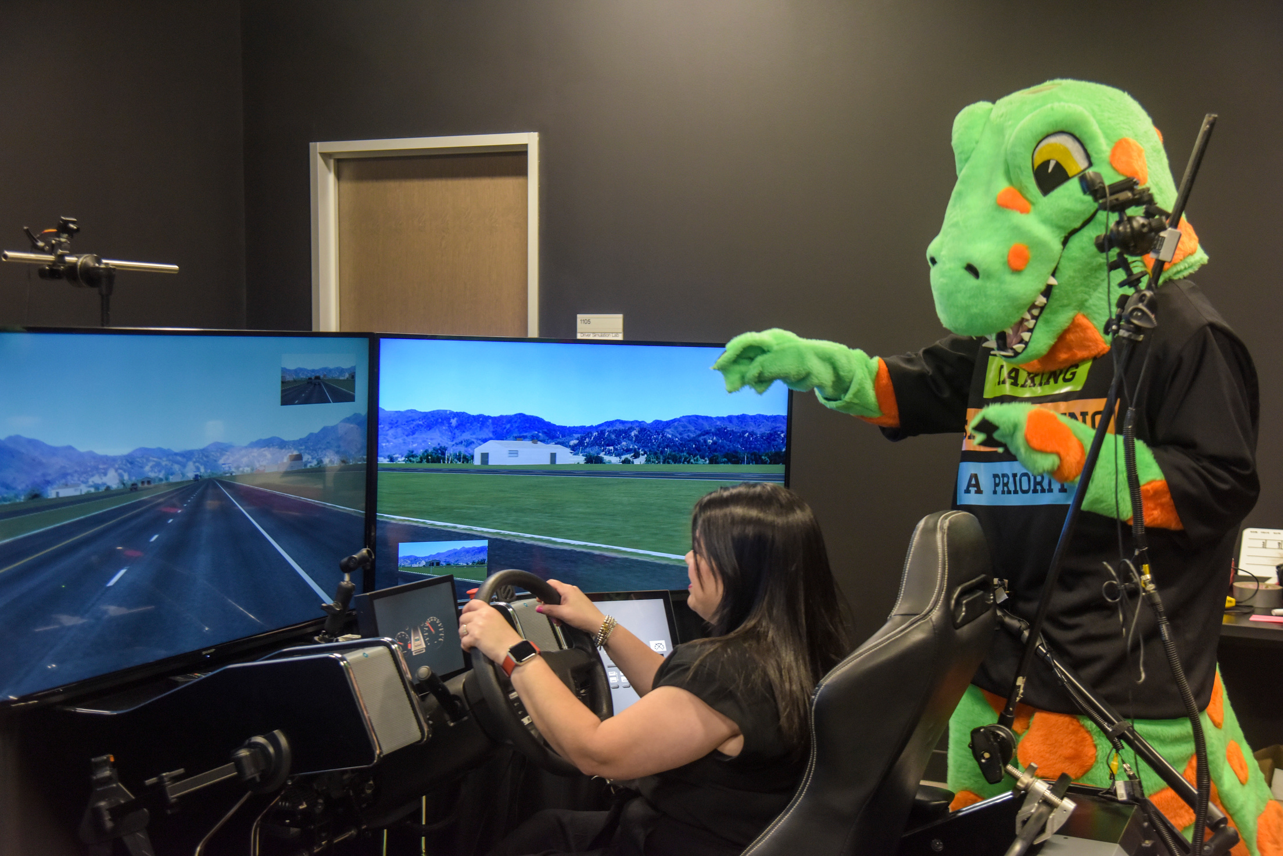

TRUE
1) I know friends and/or family members that drive recklessly.
OR
2) I know friends or family members who believe they will not be in a crash.
FALSE
Notes:
These questions help establish an understanding of what a student's social environment may include related to these types of behaviors. It is important to recognize that youth may be influenced by these types of dangerous behaviors, therefore, awareness of them can help to change them. If they have family members or friends who do this, how can we change it to create a safer community for everyone?
Feel free to adapt this however you see fit depending on class types and level of confidence in addressing these issues. Students may not feel comfortable answering these in a public setting.
After students answer this slide, you're going to transition to the lesson with passage and questions.

Slide 12
READING PASSAGE
Let’s work on reading this passage and answering the questions.
Once finished, make sure to go back to the KWL and complete the letter ‘L’ on what you learned based on today’s lesson.

Slide 13
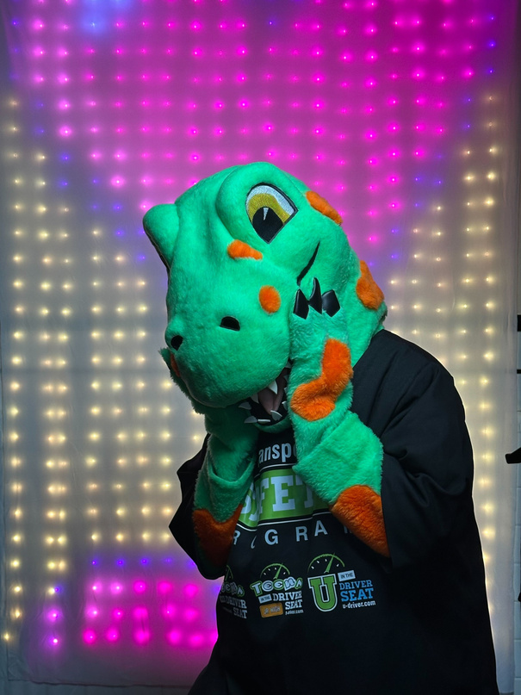
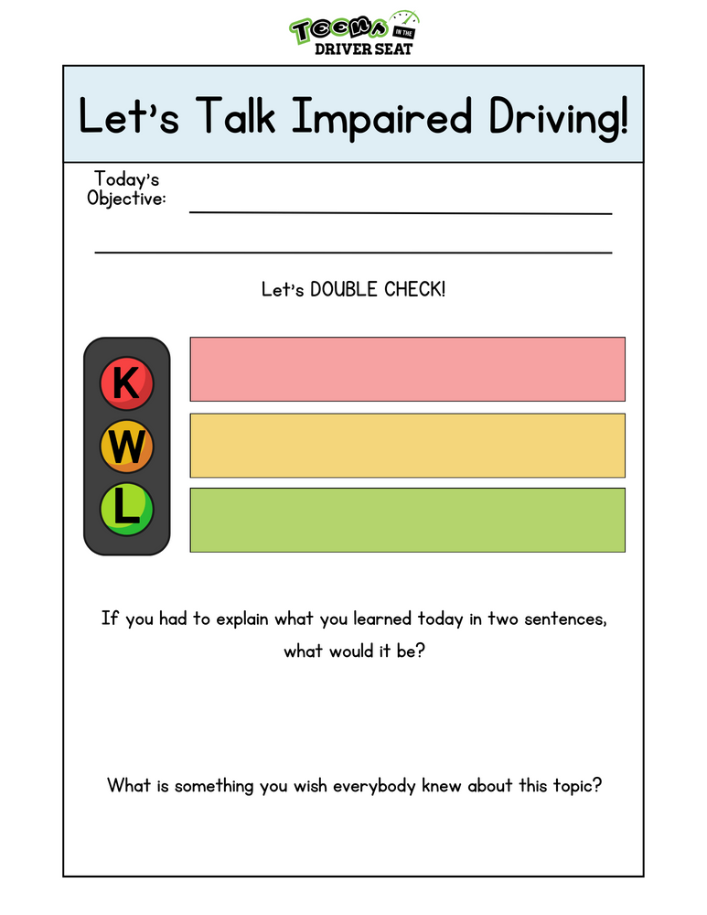
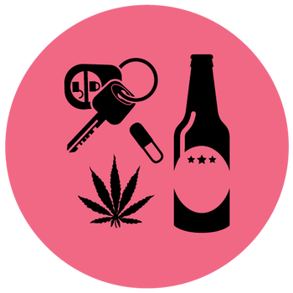
LET’S WRAP UP!
Using the handout, make sure to complete it and turn it in along with the questions and KWL.

