Slide 1
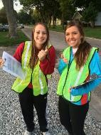
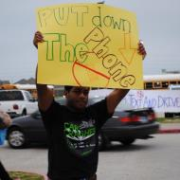
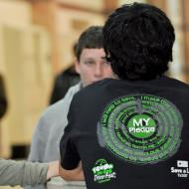
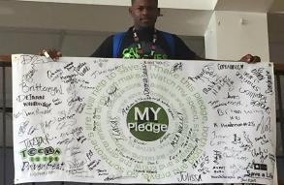
STOPPING THE #1 KILLER OF TEENS IN AMERICA
Notes:
Teens in the Driver Seat is a peer-to-peer program that focuses on the number one killer of teens in America – car crashes.
[INTRODUCE YOURSELF AND TEAM MEMBERS]
Today, we are going to cover the top 5 risks we face behind the wheel and what we want to do to prevent these risks in our school and community.

Slide 2
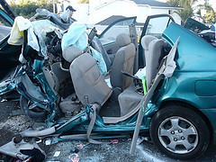
TOO MANY TEENS ARE DYING
Motor vehicle crashes are the #1 killer of teens in America
About 400 junior high teens die each year in car crashes
(Source: NHTSA, FARS data)
Notes:
This is why we are here. Car crashes are the number 1 cause of death of teens – us - in America. We want to talk to you about how to change this number and how to be safer on the roads.
[HERE YOU CAN DEDICATE THE PRESENTATION TO LOST FRIENDS AND FAMILY MEMBERS. YOU CAN ALSO ASK STUDENTS TO CALL OUT NAMES OF LOVED ONES WHO HAVE BEEN INJURED OR KILLED IN A CAR CRASH OR TALK ABOUT YOUR OWN EXPERIENCE.]

Slide 3
TOP TEEN DRIVING RISKS
Night/Drowsy Driving
Speeding/Racing
Distractions
Low Seat Belt Use
Impaired Driving
Driver inexperience is the #1 cause for teen crashes along with these following situations:
Notes:
The top risks we face behind the wheel include some we know the least about. They are: nighttime driving / drowsy driving; speeding; distractions while driving; not wearing a seat belt; and driving under the influence. We’re going to talk about each of these and ways we can help each other stay safe.

Slide 4
TOP RISKS FOR PASSENGERS 11 TO 15
If you are under 16, you are a lot safer buckled up in the back seat
It’s more dangerous to ride with a young driver (under 24) than it is with drivers 25 years or older
(Sources: FARS, Partners for Child Passenger’s Safety, Chen et al. Injury Prevention, Insurance Institute for Highway Safety
Notes:
Right now, we also have risks when we get into a car, even though we are not driving. The most dangerous things we do are not wearing a seat belt, riding in the front seat and riding with young drivers.

Slide 5
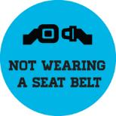
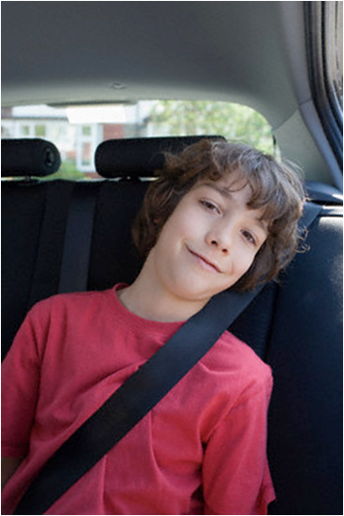
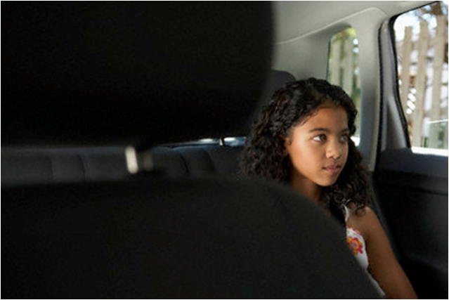
SAFETY BELT USE
A seat belt is your best and last protection in a crash
Being buckled up helps keep you safe inside the car during a crash
You need to have your seat belt on so the air bag can do it’s job. If you are not buckled up, the air bag could hurt you.
Buckle up every time you get into a car
Notes:
First, let’s talk about seat belts
If you are not buckled up, you may be thrown from the car and that is almost always deadly.
Air bags are supposed to work with seat belts, not replace them. If you don’t wear your seat belt, you could be thrown into an opening airbag and be injured or even killed.
Always put your seat belt, no matter where you are sitting or how far you are going. Most crashes happen within 10-minutes away from home, so buckle up every time.
Passengers under 4-feet 9-inches should sit in the back. Also, if the front seat belt does not fit, you should sit in the back seat.

Slide 6
BUCKLE UP – EVERY TIME!
The seat belt should fit across the center of your chest (not your neck) and across your hips (not your stomach). If not – move to the back.
If you MUST ride in the front seat, move the seat as far back as it can go, away from the air bag.
Notes:
You may need an adult to help with this demonstration.
[ASK: WHO HERE IS UNDER 4’ 9” (ASK, DON’T POINT OUT ANYONE) BRING THE VOLUNTEER UP AND ASK HIS/HER NAME. TELL EVERYONE IF YOU ARE AROUND [Name of person]’S HEIGHT, YOU SHOULD BE IN THE BACK SEAT]
[KEEP THE VOLUNTEER THERE AND DEMONSTRATE THE FOLLOWING BY HAVING HIM/HER SIT IN A CHAIR – SHOW HOW THE BACK SHOULD BE UP AGAINST THE SEAT, THE KNEES BENT AT THE EDGE OF THE SEAT SO LEGS ARE NOT STICKING OUT]
Some of you may also need a booster. To check if you are ready for a seat belt alone: You should be tall enough to sit with your back against the back of the seat with your legs bent over the edge of the seat, and feet hanging down. The shoulder belt should be across your chest and shoulder and not cut across your neck or face. The lap belt is low and snug across the thighs, not across the belly.
A seat belt has to be worn right to help save you – if you like to lay the seat back you can slide out from under it.
If you put the chest strap behind you, you can still be thrown forward.
If it the belt goes across your stomach, it can cause internal injuries.
You can also help out the driver and ask all passengers to buckle up.
[SHOW ON YOUR BODY WHERE THE SEAT BELT SHOULD GO. SHOW THE HIPS UNDERNEATH THE BELLY.]

Slide 7
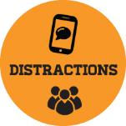
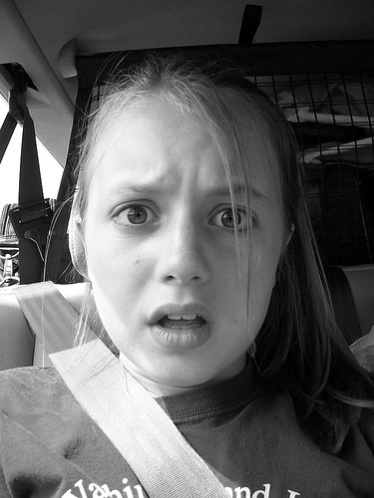
RIDING SAFELY
Sit in the back seat and buckle up
Don’t disturb the driver
If you see the driver being careless or unsafe, speak up – it’s your safety!
Notes:
Here are some easy things we can do to be safe in the car. It’s all easy stuff, right?

Slide 8
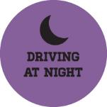
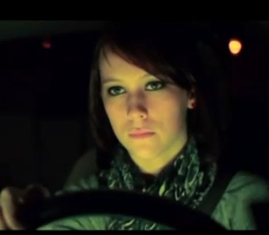
RIDING AT NIGHT
Be a helpful passenger by helping stay on the look out for things the driver may not see – other cars, animals or road signs
If the driver is having a hard time staying awake, you can keep them company, turn on the radio, or suggest taking breaks
Notes:
What can we do to help a driver stay safe at night?
- Always wear your seat belt.
- Keep distractions away, like offering to change the radio or answering cell phone calls, and help the driver concentrate on the road.
Make sure headlights are turned on at dusk.
Keep the driver company if they seem tired.

Slide 9
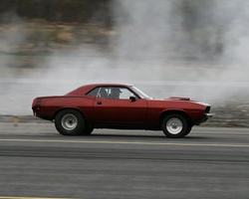
SPEEDING
Watch for speed limit signs and let the driver know when it changes
Street racing is dangerous and illegal
Reckless driving means you are driving in a way that shows you really don’t care about other’s safety – and, it’s against the law
Notes:
The faster a car is going above the speed limit, the more chance there will be a crash and people will be hurt.
What can we do about it?
-Going fast may seem fun, but the danger increases a lot. Don’t encourage the driver to go fast.
Help the driver watch speed limit signs
Again, the safest place for you is buckled up in the back seat.

Slide 10
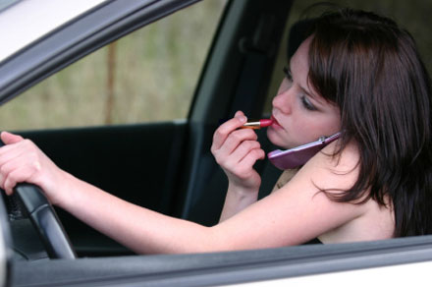
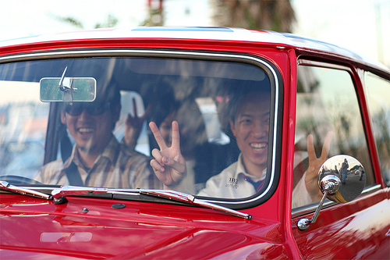
WHAT ARE DISTRACTIONS?
Anything that:
Takes your eyes off the road
Takes your hands off the wheel
Takes your mind off driving
Photo by Aaron Dieppa
Notes:
Distractions are a big deal. To drive safely the driver must be paying attention to what they are doing. If they are eating, texting, putting on makeup, or turned around talking to their kids in the back seat, they are distracted.
It’s not just teens who try to drive and do other things at the same time. It’s adults too.

Slide 11
KEEPING DISTRACTIONS OUT OF THE CAR
Listen to games, movies or other electronics at a normal volume
Stay in your seat and buckled up
Ask if you can answer cell phone calls or text messages for the driver
Help with younger brothers and sisters to keep them from distracting the driver
Notes:
[ASK THE AUDIENCE] What can we do about texting or talking on the phone while driving?
-Be the designated talker or texter – ask the driver to pass the phone
-Don’t text someone if you know they are driving
-When you call someone on their cell phone, ask them first if they are driving. If they are, ask them to call you back when it’s safe to talk.
-Place phones and devices in the trunk or turn them off
[ASK THE AUDIENCE] The more people in the car, the more easily drivers are distracted. So, what about other distractions? How can we help?
-Be a good friend by being a good passenger. Buckle up and help the driver by watching out for dangers.
-Respect the driver. Get to where you are going – safely – so then you can have fun.
-Don’t be afraid to speak up if someone is bothering the driver. It’s your safety too.

Slide 12
DRIVING UNDER THE INFLUENCE
Drivers who have been drinking use seat belts less and speed more
When young drivers drink and drive they are much more likely to crash, especially if there are other young people in the car
(Source: NHTSA, Traffic Safety Facts)
Notes:
Alcohol has a big effect on driving skills. Because of its effects, drivers can think they are okay to drive, but are really not. Drivers who have been drinking:
Can’t react as fast – like stopping or turning quickly if they need to.
Can’t see as well
Have a hard time judging where other cars are, seeing the center line clearly, and paying attention to road signs
Can’t pay attention as well and may easily become tired
Make bad decisions
Have bad coordination – the eye/hand/foot coordination that is so important for driving

Slide 13
STAYING SAFE AROUND DRUGS AND ALCOHOL
Alcohol affects everyone differently, so if someone has been drinking, assume they are unable to drive and don’t get in the car with them
If a driver has been drinking or doing drugs:
Walk, bike or find another ride
Let a responsible adult know
Tell the driver to call someone for a ride
Notes:
[ASK THE AUDIENCE ]What are some ways we can prevent drinking and driving?
-If someone you’re riding with someone who begins drinking, stop them immediately
-If you get in the situation where someone has been drinking, ride with a sober friend, ask someone else to drive or call a parent or older sibling.
-If a friend has been drinking and is about to drive, speak up. Take the keys or call a parent.
-Never get in the car with a driver who has been drinking. Everyone reacts to alcohol differently.

Slide 14
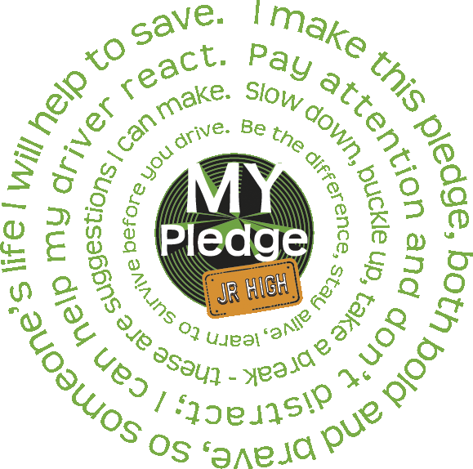
SAFE DRIVING PLEDGE
I make this pledge both bold and brave, so someone’s life I will help to save. Pay attention and don’t distract; I can help my driver react. Slow down, buckle up, take a break – these are suggestions I can make. Be the difference, stay alive, learn to survive before you drive.
Notes:
We’re all in this together and we want to challenge each of you to be safe and speak up when you see someone doing dangerous things in a car. Whether you know you need to be safer or you know someone who does, please keep talking about these dangers and let’s take care of each other. Be a friend by keeping our drive alive.
Most of all, if you don’t feel comfortable getting in a car, then DON’T. Use your parents as an excuse (“It’s my parent’s stupid rule”). Practice this so it’s easier to say when you need to use it. And, when you are in a car, remember what we’ve talked about - buckle up, sit in the back seat, and be a good friend by being a good passenger.
[HERE YOU CAN HAVE EVERYONE READ THE PLEDGE ALOUD THEN TALK ABOUT SOME ACTIVITIES YOU HAVE PLANNED. YOU CAN ALSO HAVE THE PLEDGE AVAILABLE TO SIGN.]

Slide 15
STOPPING THE #1 KILLER OF TEENS IN AMERICA
Notes:
Teens in the Driver Seat is a peer-to-peer program that focuses on the number one killer of teens in America – car crashes.
[INTRODUCE YOURSELF AND TEAM MEMBERS]
Today, we are going to cover the top 5 risks we face behind the wheel and what we want to do to prevent these risks in our school and community.

